Slide 1



Serverless Authentication Using AWS Cognito

Slide 2

INTRODUCTION
“Amazon Cognito” is a powerful authentication and authorization service managed by Amazon Web Services (AWS) and is often combined with Amazon API Gateway and AWS-Lambda to build secure serverless web services ,When building a complex web service such as a serverless application, sooner or later you must deal with permission control.
It provides authentication, authorization, and user management for your web and mobile apps. Your users can sign in directly with a user name and password, or through a third party such as Facebook, Amazon, Google or Apple.
The two main components of Amazon Cognito are user pools and identity pools. User pools are user directories that provide sign-up and sign-in options for your app users. Identity pools enable you to grant your users access to other AWS services. You can use identity pools and user pools separately or together.

Slide 3
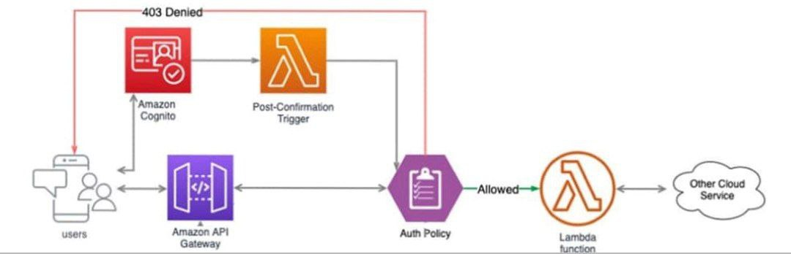
Architecture

Slide 4
User and identity pools
A user pool and Identity pools support anonymous guest users . With these your users can sign in to your web or mobile app through Amazon Cognito, or federate through a third-party identity provider (IdP). Whether your users sign in directly or through a third party, all members of the user pool have a directory profile that you can access through an SDK.
Sign-up and sign-in services.
A built-in, customizable web UI to sign in users.
Social sign-in with Facebook, Google, Login with Amazon, and Sign in with Apple, and through SAML and OIDC identity providers from your user pool.
User directory management and user profiles.

Slide 5
Adding user pool sign-in through a third party
When you connect Amazon Cognito to social, SAML, or OpenID Connect (OIDC) IdPs, your user pool acts as a bridge between multiple service providers and your app. To your IdP, Amazon Cognito is a service provider (SP). Your IdPs pass an OIDC ID token or a SAML assertion to Amazon Cognito. Amazon Cognito reads the claims about your user in the token or assertion and maps those claims to a new user profile in your user pool directory.
Amazon Cognito then creates a user profile for your federated user in its own directory. Amazon Cognito adds attributes to your user based on the claims from your IdP and, in the case of OIDC and social identity providers, an IdP-operated public userinfo endpoint. Your user's attributes change in your user pool when a mapped IdP attribute changes. You can also add more attributes independent of those from the IdP.
After Amazon Cognito creates a profile for your federated user, it changes its function and presents itself as the IdP to your app, which is now the SP. Amazon Cognito is a combination OIDC and OAuth 2.0 IdP. It generates access tokens, ID tokens, and refresh tokens.

Slide 6
Adding user pool sign-in through a third party
Although Amazon Cognito offers visual tools such as AWS Management Console integration and the hosted UI, AWS has designed the service to work with your app code. You can configure certain components of Amazon Cognito with only the API or the AWS Command Line Interface
When new users discover your app, or when existing users return to it, their first task is to sign up or sign in. When you integrate Amazon Cognito with your client code, you connect your app to AWS resources that aid authentication and authorization workflows.
For example, your app uses the Amazon Cognito API to create new users in your user pool, retrieve user pool tokens, and obtain temporary credentials from your identity pool. T

Slide 7
Integrating with aws cognito
Use IAM roles with Amazon Cognito. Some of the services used
Service limits and quotas for Amazon Cognito user pools requests and resources.
Once the Amazon Cognito credentials provider is initialized and refreshed, you can pass it directly to the initializer for an AWS client.
Before you use IAM to manage access to Cognito, learn what IAM features are available to use with Cognito
AWS services are in scope of a specific compliance program.
You can monitor Amazon Cognito user pools using Amazon CloudWatch or using Service Quotas. CloudWatch collects raw data and processes it into readable.
You can enable your users to sign-in with a user pool, and then access AWS services using an identity pool.
You can view and manage your Amazon Cognito user pools quotas from a central location with Service Quotas

Slide 8
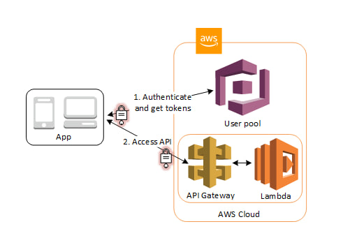
After a successful authentication, your web or mobile app will receive user pool tokens from Amazon Cognito. You can use those tokens to control access to your server-side resources. You can also create user pool groups to manage permissions, and to represent different types of users.

Slide 9

User pool management
In the first step your app user signs in through a user pool and receives user pool tokens after a successful authentication.
Next, your app exchanges the user pool tokens for AWS credentials through an identity pool.
Finally, your app user can then use those AWS credentials to access other AWS services such as Amazon S3 or DynamoDB.

Slide 10
User pool management
After you create a user pool, you can create, confirm, and manage user accounts. With Amazon Cognito user pools groups you can manage your users and their access to resources by mapping IAM roles to groups.
You can import your users into a user pool with a user migration Lambda trigger. This approach enables seamless migration of users from your existing user directory to user pools when they sign in to your user pool for the first time.

Slide 11

Thank you

